Slide 1
Overview of the CRC reporting process 2019-22 (UK)
Sean O’Neill, Children in Wales
State of Children’s Rights in Wales Project
https://www.childreninwales.org.uk/our-work/rights/state-childrens-rights-wales
crcwales@childreninwales.org.uk

Slide 2
Overview
UN have introduced a new way of reporting to UN Committees, including the CRC Committee, called the Simplified Reporting Process (SRP)
“the simplified reporting procedure streamlines and enhances the State party review by rendering it more focused and effective, as both the constructive dialogue and concluding observations focus on areas that the treaty body concerned sees as priority areas for consideration in a given State party at a given point in time”.
A new reporting process
More focused & effective way of reporting= Priority areas identified at the very beginning
Help Governments be better guided in their follow up work with less and more specific issues/priorities to work on (via Concluding Observations)

Slide 3
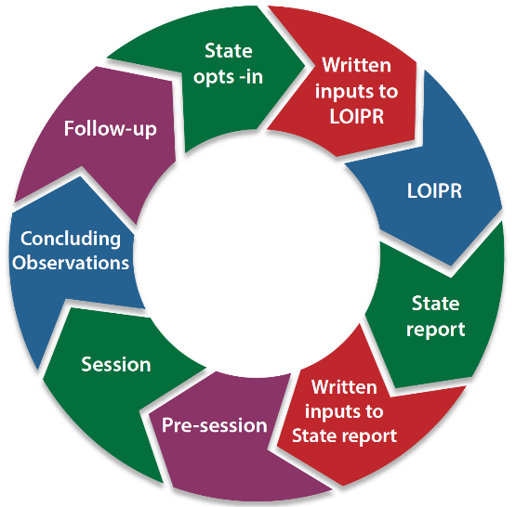
Simplified Reporting Process
LOIPR = List of issues prior to reporting
© Child Rights Connect

Slide 4
Reporting Stages
STAGE | ACTION | TIMESCALES | PROGRESS
1 | States opt in | JUL 2019 | ACCEPTED
2 | (Civil Society) submit a report of our priorities to the UN to inform their ‘List of Issues’ | 1st NOV 2020 | IN PROGRESS
3 | UN will invite a response from the State Party (Gov.) to their ‘List of Issues’ | FEB 2021 (1 year to respond)
4 | State Party (Gov.) responds | Feb 2022
5 | (Civil Society) submit a response to State Party (Gov.) report | May 2022
6 | CRC Pre-Session Hearing | June 2022
7 | CRC State Party Hearing & Concluding Observations | September -October 2022

Slide 5
Why get involved?
Opportunity to raise issues, concerns and influence change
Hold decision makers to account on their obligations
Represent and support children to get their voices heard
Build a broader Child Rights community in Wales
How to get involved!
Share you views TODAY &….
Respond to the Call for Written Evidence by 11th September (crcwales@childreninwales.org.uk)
Be acknowledged in the Civil Society Report (October)
Future – engage with UN Committee and/or Governments

