Slide 1

Brexit research.
Notes:
Ensuring that Children and Young People’s voices are heard by Ministers and decision makers.

Slide 2
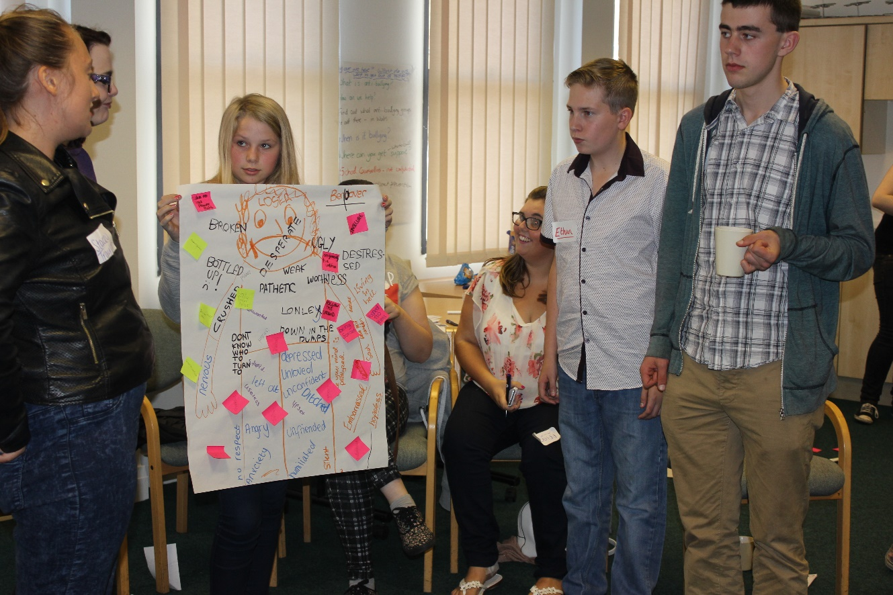
What we did
Notes:
The information this work was gathered through workshops in schools, with youth clubs and youth forums together with online and Instagram surveys.
The Young Wales team delivered 39 workshops between April and October 2018 in a variety of settings and locations across Wales.
Children and young people aged 8 – 21 participated in workshops. More than 650 children and young people have participated.
The workshops have varied in length, ranging from 45 minutes to 2 hours, depending on the amount of time the schools, groups or youth forums could make available. The style and content of workshop has varied depending on the age range, group members and setting. Preparation for every session considered the specific needs of the group.
Three different workshops were developed as a framework for working with different age groups and in different settings.
The workshops have evolved as the project has progressed to reflect the feedback from young people, the development of new resources and also to reflect the most recent news and policy announcements on Brexit.

Slide 3
Social Media.
Twitter
Instagram
Online survey
Brexit animation
Notes:
Twitter – Daily messages were shared to promote on line resources and to identify upcoming activities and events.
Instagram – Young People over 13 years old were encouraged to log on and follow Young Wales Instagram, to answer the Young Wales Brexit poll. A new Brexit Question was posted on Instagram every day.
On-line survey – The survey gave young people an opportunity to give their views on Welsh Government priorities in Brexit negotiations. The survey was also posted on the Young Wales twitter account @youngwalesciw. The survey took less than 5 minutes to complete. Young Wales received 455 responses to the online Survey.
Brexit Animation – Young people from North and South Wales have been involved in designing and developing an animation that will reflect a range of young people’s views. This work is being finalised.

Slide 4
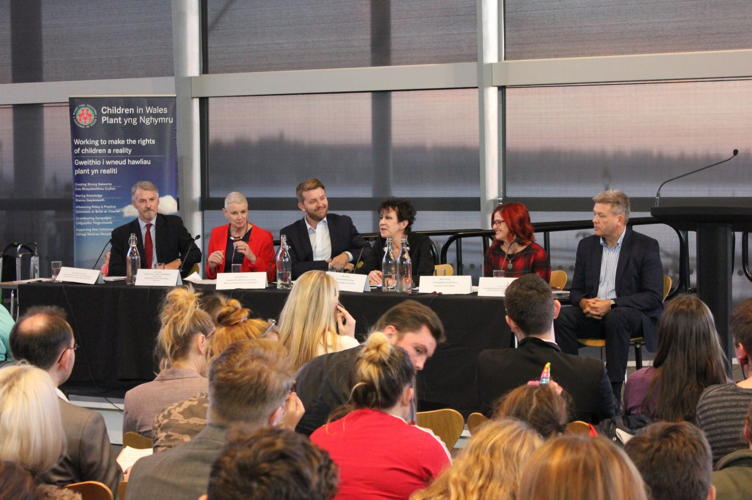
Question time.
Notes:
Question Time in the Senedd attended by 50 young people.
Chaired by James Williams, BBC Cymru Wales Brexit Correspondent
The Panel: included Huw Irranca Davies AM, Minister for Children Older People & Social Services
Ruth Coombs, Head of Wales, Equality & Human Rights Commission, and Meri Huws, Welsh Language Commissioner
Brexit - general
What is Brexit? -
People don’t know what’s happening with Brexit so how can they comment – what’s happening?
Why is Brexit going to affect young people?
Are you able to give an example of where young people’s views have been taken into consideration when negotiating the Brexit deals?
Studying abroad
Will Brexit affect university students who want to study abroad with their course, within Europe?
Funding
The EU has given the UK government £680 million specifically targeted at Wales, which has supported things like sports and arts facilities and jobs creation. How can we make sure that the same amount of investment comes to Wales after Brexit?
Wales relies on funding from the EU so how will that change when we leave?
How much money will the UK need to pay the EU before leaving and how will it affect the UK economy?
How do you forecast the changes in the financial sector with regards to Brexit?
Will Brexit make sure that more money goes towards the Welsh NHS (in particular CAMHS) and youth services?"
Future of Wales and Brexit negotiations
Regarding the question of Brexit, can Wales re-identify itself as a separate nation, from the shackles of English dominance, via finance and the systems of MP’s, imposed by the British Government, like the example of Scotland respectively?
Why have we only heard of the dealings with European Union and not with many other nations, rather than the three in Africa that the Prime Minister went to this year?
How will Wales’s relationship with the UK change?
Farming & Fishing
What does Brexit mean for farmers? Faring is one of the most important industries in Wales but will trade agreements lead to more farmers becoming bankrupt?
Why should the EU countries be able to come over here and take our fish and ya get nothing in return?
Environment
I believe that the younger generation (who didn’t get to vote) are the ones who care the most about our environment. We want Wales to be a safe and clean place to live but after Brexit what’s going to happen to all those environmental standards and protections on things like air and water pollution that have come from the EU? Is there a danger that we’ll fall behind the rest of Europe?
What will happen to things like blue flag beaches?
Rights / EU Migration
Brexit will likely affect all aspects of life, but one aspect that is most troubling is our rights, as both children and human beings. What is being done to make sure that our rights will be protected no matter what deal happens.
How will UK citizens living elsewhere in the EU be affected by Brexit and how will it affect EU citizens living in the UK?
I am Romanian, what will happen to me after Brexit, What are my rights as a European citizen.
How will UK citizens living elsewhere in the EU be affected by Brexit and how will it affect EU citizens living in the UK?
Welsh Language
Welsh is the most important thing to me. I want people to respect the fact we speak welsh. Why do we always have to justify the fact we want to speak welsh? What impact will Brexit have on this?
Opportunities for young people
How will Brexit effect the work (opportunities) of young people in the future?
How do you believe Brexit will affect young people’s future?
Getting on a housing ladder is already difficult for young people, will the ‘Help to Buy’ scheme be replaced as it is something EU created.
Other questions:
Given that Council Tax Rates are different in the areas of Wales like Blaenau Gwent, of which is low and Caerphilly, of which is high. What impact will Brexit have on these rates, will they lower, remain or heighten overall?
Regarding the question of Brexit, will it bring an era of unity, strong vision, etc…embodied in a leader who can take the helm of the ship, that is Wales overall?
Regarding the question of Brexit, can Wales re-identify itself as a separate nation, from the shackles of English dominance, via finance and the systems of MP’s, imposed by the British Government, like the example of Scotland respectively?
Regarding the question of Brexit will it bring an era of effectively sorting out the Criminal Justice System in the borders of Wales, or just letting it descend into further anarchy in terms of financial turmoil, prison violence and so on?
Regarding the question of Brexit and of food supplies within the borders of the United Kingdom, will the Welsh Government create proposals that are more favourable to people moving away from obesity to good health in regards to consumption of food in Wales (Epidemic levels) at this present time?
How will this affect Gibraltar?
If young people voices are important now why were 16-17 year olds not allowed to vote in the referendum?

Slide 5
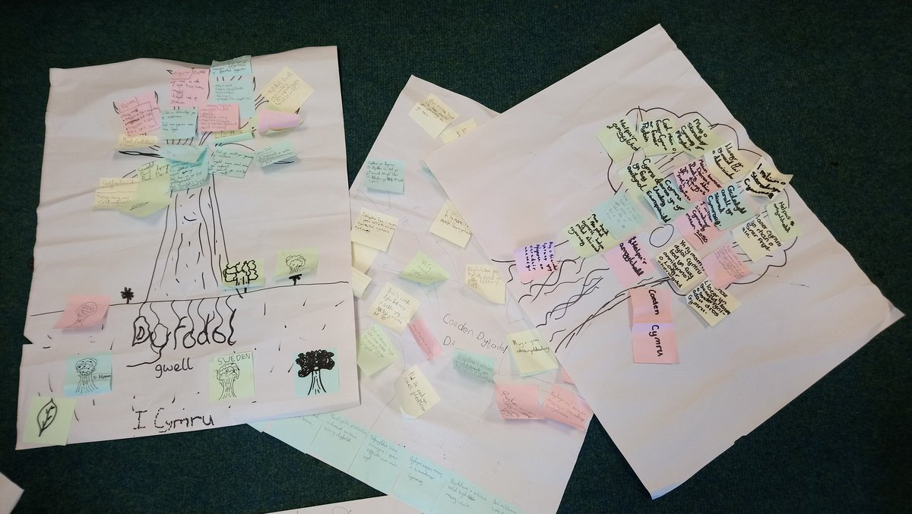
Children told us …
Notes:
Workshops in Primary Schools.
Summary of findings from Primary School Workshops
Where / When/ Who have you heard talking about Brexit?
Who – Parents and family, farmers, politicians (David Cameron, Teresa May, Jeremy Corbin were specifically named).
Where – News, TV, (BBC and S4C) and radio and Newsround on TV.
Brexit also discussed in school and at Brownies.
When – All the Time!
What issues are important for Welsh Government to consider for the future of Wales? In groups, pupils were given flipchart paper with an outline of a tree Post it notes were used as leaves to note issues important to them for Wales in the future.
The areas of concern that primary schools pupils identified on their ‘trees are identified below, in order of priority.
The Enviroment: “Less people using cars, more people travelling by train, bus or walking and cycling. I’d like to see a green Wales without pollution.”
The Community and a Peaceful Society: “I would like to see Wales as a famous and strong place, I want a world where everyone is kind and nice and more respect for the community.”
The Welsh Language: “More welsh schools, Welsh a living language forever….and ever.”
Financial: “More money for doctors, policemen, less for stars and sporting stars.”
Political: “Have another referendum, but learn more about it, then we would be ready for a referendum.”
Social Media: The workshop generated much interest on social media not only from here in Wales but also across Europe, for example:
@Eurochild_org Mar 29
More
Some positive news coming from Brexit negotiations - Welsh government to ask views of #children Congrats @ChildreninWales and @YoungWalesCIW for bringing #childparticipation to the political agenda! https://bit.ly/2GAiVyH #BrexitCYPWales

Slide 6
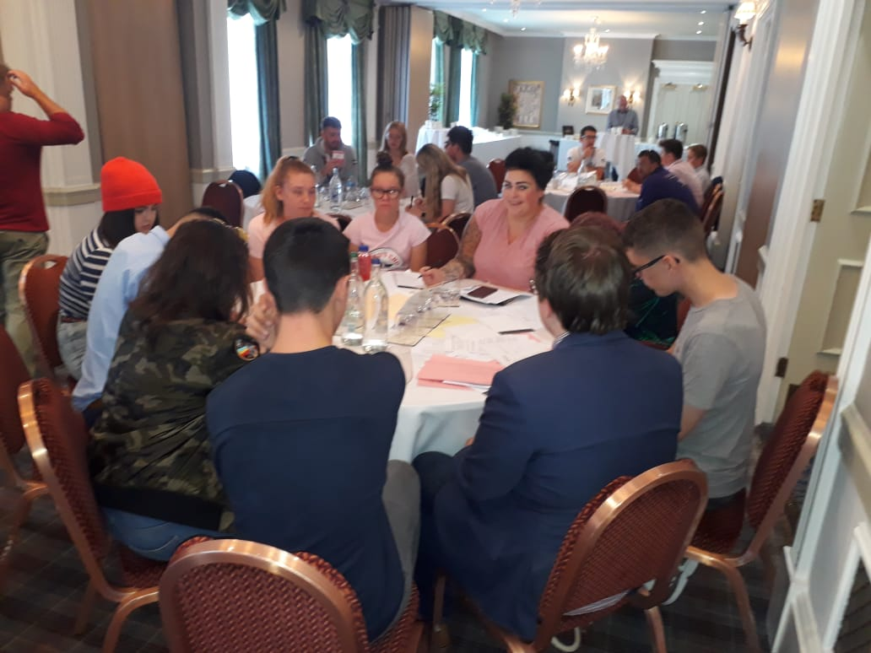
Young people told us…
Notes:
Summary of findings from Secondary Schools.
Question: What are the top three issues most important for Wales
Environment: “Fly tipping causes pollution and it makes Wales dirty and it is ruining our mass amount of tourism.”
Ability to Travel: “Easy travel to different countries, because I would like to live abroad or go to university/ college abroad or live abroad”
Education: “Education to be varied and include things that are needed when you’re older; being taught things such as politics because if younger people are uneducated, it’s harder to vote. More education about politics”
Human Rights:
“A country where we have all our human rights, because people will stay healthy and death rate won’t increase.”
“Help immigrants as they’re human and deserve to have their human rights.”
Prosperous communities.
“A place with lots of wealth, with more money so our communities will be stronger.”
Trade: “To be high up in the single market, so companies will stay in Britain and have jobs and it will make money.”
Health and Wellbeing: “Prioritise NHS, it is important that everyone has health care.”
Improved services and facilities: “More clubs for kids to decrease boredom and anti-social behaviour.” “Keep youth centres open.”
Votes at 16: “The voting age to be dropped to 16, because I believe more younger people should have the chance to vote.”

Slide 7
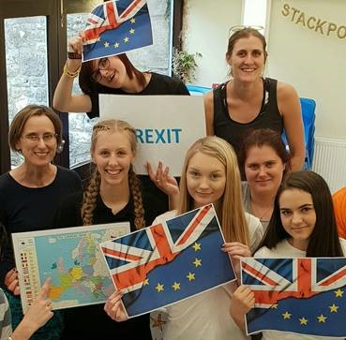
Young people told us …
Notes:
Question: What are the top three issues most important for Wales?
Education: “We need opportunities for studying abroad, concerned there will be less opportunities to study abroad and it could be more expensive.”
National Health Service: “Funding mental health facilities, there’s not enough funding as there is especially for young people. Ensure good mental health services for young people.”
Economic Growth EU and/or Global relationships: “Ensure continuation of social funds as they have been a massive benefit to Wales.”
Freedom of movement and travel: “Young people need the opportunity to be able to see the rest of the world. I’m hoping to go to University next year and considering a year abroad however it could be more difficult or not possible.”
Engaging young people: “We should be kept up to date with what’s going on. The news is too complicated to follow around Brexit.”
Votes at 16: “Brexit is going to affect us when we are older but we have not been able to have our voices heard like everyone over the age of 18 which is unfair.”
Youth Voice: “We are the next generation and it will affect us especially”.”Brexit will impact on me as a person and as a country.”
In order to capture as wide a range of views as possible workshops were held with the Ethnic Youth Support Team (EYST) in Swansea, Young Farmers Cymru, and the North Wales Project Board.

Slide 8
Key issues.
Not enough information for young people.
Young People want to be engaged in and understand politics.
Concerns for the future.
Notes:
Question: Is there enough information available for young people around Brexit?
Most groups replied to this question with a 100% no, many saying that they did not have or had not seen any information aimed at young people.
One group reported a result of 80% No and 20% Yes.
One group responded with a very clear no from all 35 participants.
Comments gathered during discussions:-
Enough information is available but I just don’t know what is true or not true.
There’s information but I don’t understand it, it is too complicated to understand.
Too much but it’s all boring.
They told lots of lies before the referendum so I don’t know what to believe.
I hear a lot about Article 50 but it’s not made simple for young people.
Should young people be engaged with politics?
100 % -yes
Quote from workshop
“As 16 year olds are allowed to vote now we should start learning about politics at 14 so we have two years to learn what we should be voting for and create our own view so we can prepared for elections and make decisions ourselves.”
In summary:
From the work undertaken win workshops with children and young people, there has been considerable interest in the issue of Brexit and an eagerness to share their views on the issue.
Children in Primary Schools and young people in secondary schools had definite views on Brexit, all had heard about Brexit and many had been involved in previous discussions with friends or family.
As identified there was a wide range of issues covered in discussions. For children in primary schools the issues focused on environmental and community issues, the importance of the Welsh language and money to fund doctors and policemen. Children in Primary schools also referred to a second referendum.
Many of the issues identified by younger children were also important in secondary settings, such as the environment, communities, and the importance of health services. For young people other priority issues included opportunities to travel, human rights and education.
For young people in youth settings, while they also reflected many of the issues identified in secondary schools, they also identified global relationships, freedom of movement, votes at 16 and hearing youth voices as their priorities.

Slide 9
Brexit.
“We are the next generation and it will affect us especially. Brexit will impact on me as a person and on my country.”
Notes:
Summary of findings.

Slide 10
www.cymruifanc.cymru www.youngwales.wales

